Slide 1
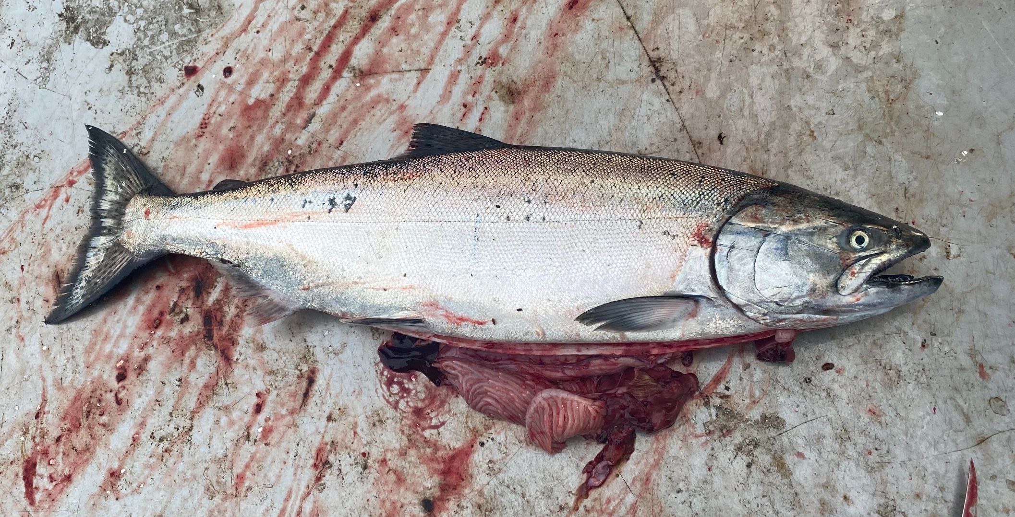


Adult Salmon Diet Program
ES 482/582 Data Project By Rebecca Hansen and Jessica Qualley April 3, 2020
Notes:
We would like to acknowledge Will Duguid, Katie Innes, Micah Qunidazzi, Nick Bohlender, and Francis Juanes for oper

Slide 2
Introduction

Slide 3
Description of Data

Slide 4
Statistical Methods

Slide 5
Results

Slide 6
Discussion

